Slide 1



Slide 2
Group Members
😁
😉
😝
😎
Izabela Rocha
Isabela Silva
Beatriz Rocha
Maria Clara Silva

Slide 3
01
Introduction
02
03
04
05
06
07
08
Problem statement
Objectives
Methodology
LIST OF CONTENTS
Who we disgned for
Fluxogram
Prototype
Proposed outcomes

Slide 4

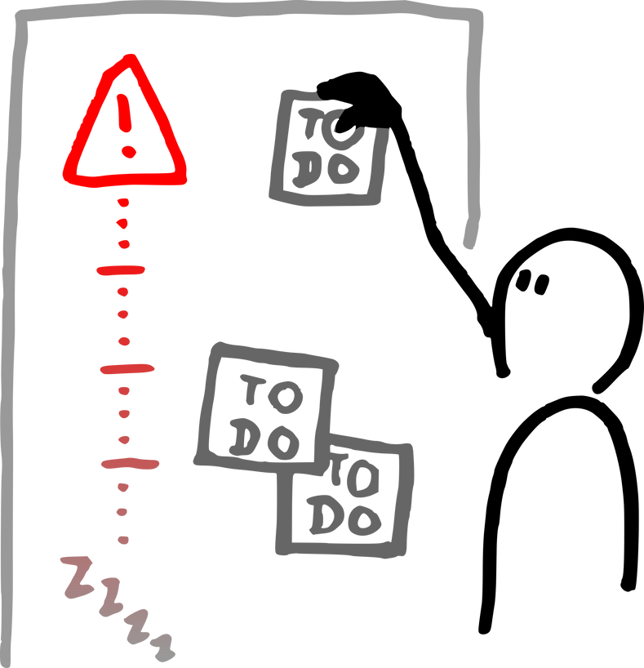
INTRODUCTION
PROJECT OVERVIEW
SOLUTION
WHY IT MATTERS
We developed a Python quiz in which users register and must type their own answers to each question.
The project provides a simple and interactive way to test knowledge, encouraging memory, reasoning, and user participation.

Slide 5

PROBLEM STATEMENT
Analyzing our target audience, we came to some conclusions; many of them reported:
Ready-made alternatives make guessing easier.
Limited challenge when testing the user’s actual knowledge.
Less interaction because users only choose between given options.

Slide 6

PROJECT OBJECTIVES
Desired Result
Develop a functional quiz system using Python and basic programming concepts.
Create an interactive learning experience by allowing users to type their own answers.
Apply programming concepts in practice, such as variables, lists, dictionaries, functions, loops, and data storage.

Slide 7
METHODOLOGY
THE STEPS TO BUILDING THE PRODUCT
Planning
Definition of questions and quiz structure
Programming
Development of the quiz using Python and JSON.
Final Result
Registration
Creation of the user registration system.
Verification
Checking answers and counting correct responses.

Slide 8

TARGET AUDIENCE
WHO WE DESIGNED FOR
Students
Teenagers

Slide 9
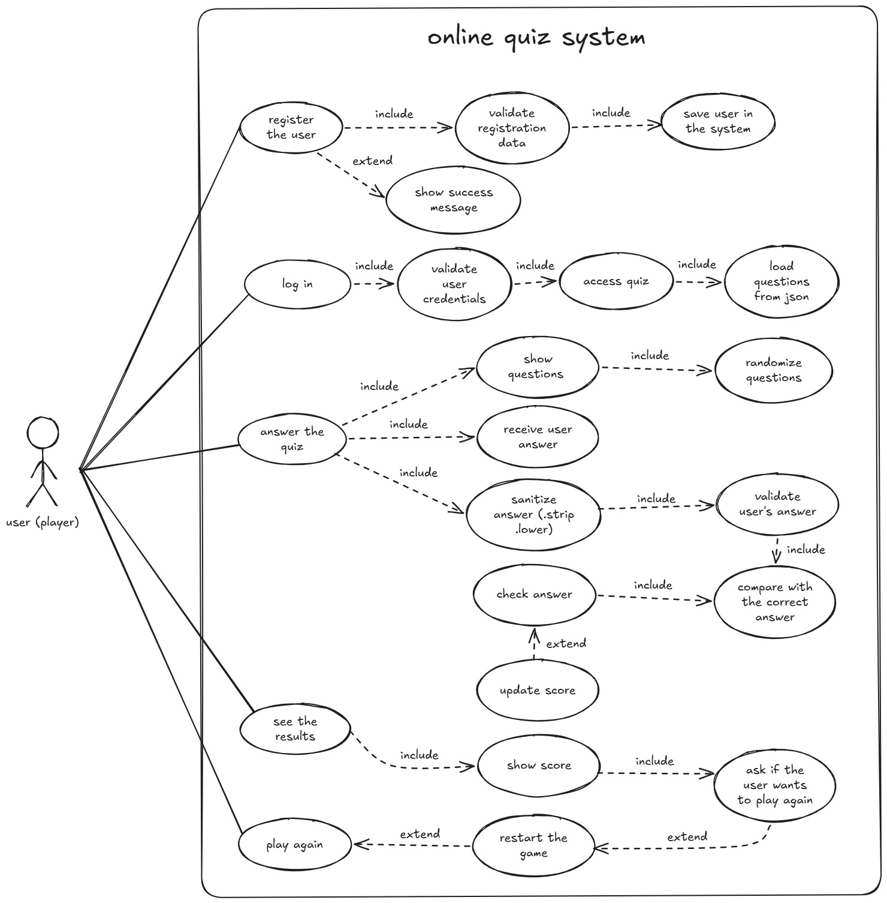
USE CASE DIAGRAM
INTERACTION OF USERS (ACTORS) WITH THE SYSTEM

Slide 10
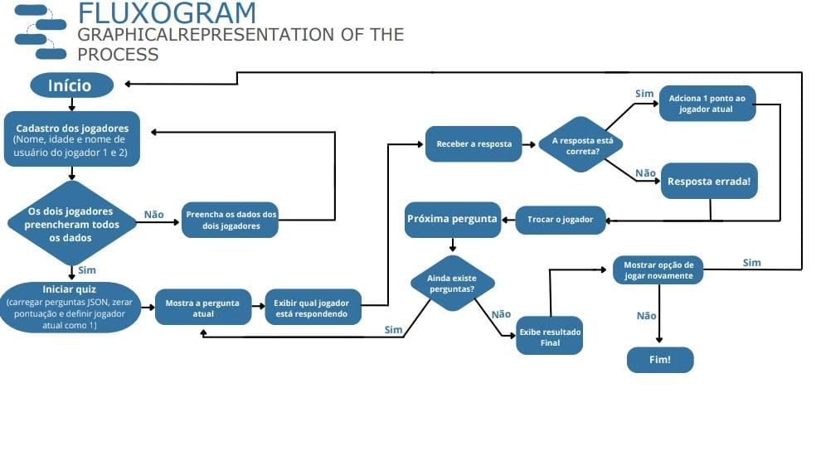
User
Create Project
Create Task
User
View Project
View Task

Slide 11



TOOLS
TECHNOLOGIES USED IN THE DEVELOPMENT PROCESS
PYTHON
JSON
STREAMLIT

Slide 12
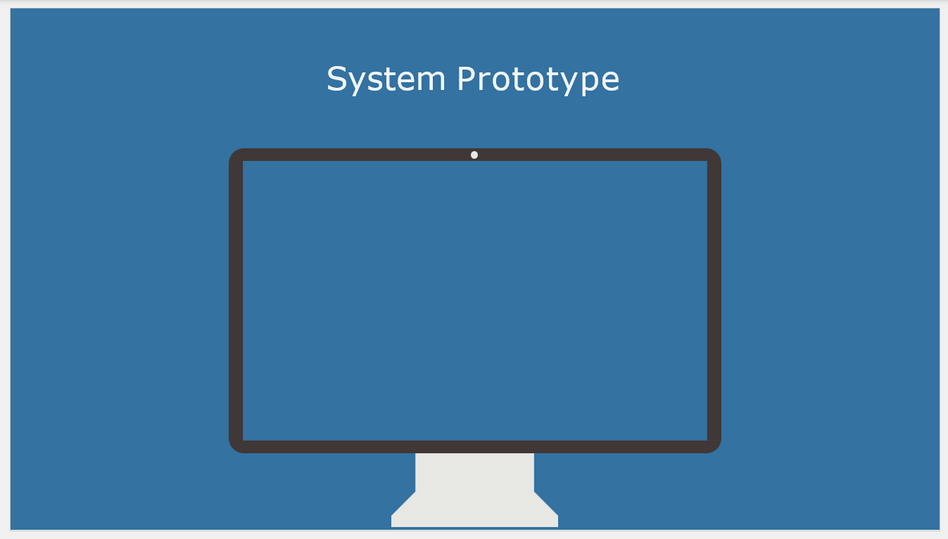


Slide 13






RESULTS
CONCLUSIONS AND EXPECTED CONTRIBUTIONS
- Integrated a validated Python backend with a Streamlit UI
- Centralized catalog with validation to prevent errors
- Automated checkout/return with real-time availability
- Blocked double-borrowing by fixing critical logic bug
- Enabled data-driven decisions via live metrics
- Result: a more organized and reliable library system

Slide 14
Thank You!
감사합니다!

